Slide 1
Corporate IT – FT 2.0
Interconnect Remote - Billing project management
NW team - Mar 2016

Slide 2
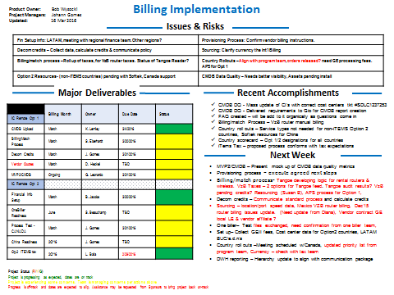
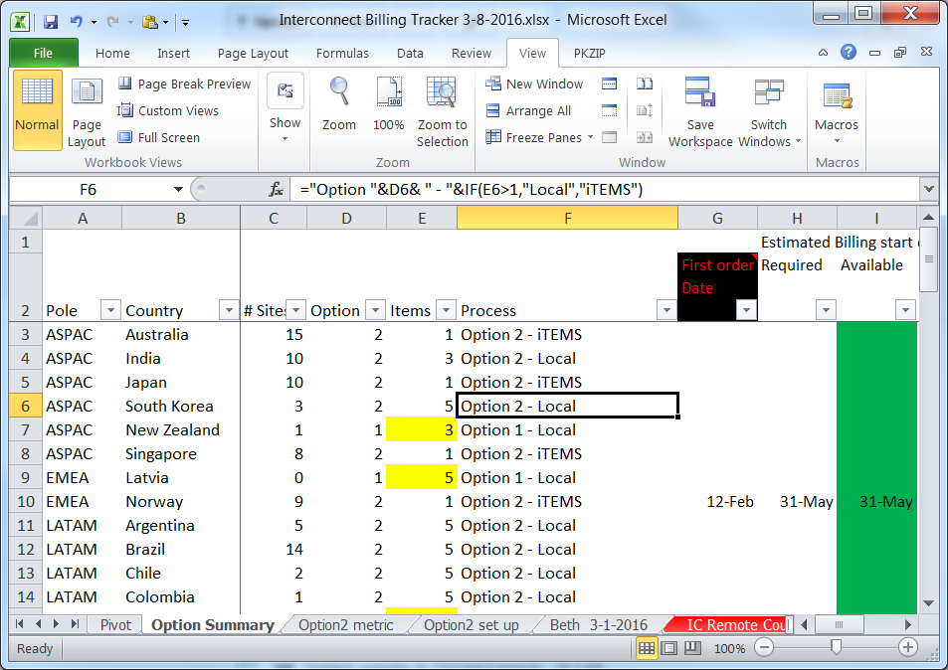
Project management rhythm
❶
Summary Update
~Billing outlook, risks/issues, key tasks
Country roll outs
~Option classification, Order status, billing readiness
Metrics dashboard
~CMDB Data quality, billing process data
❷
❸
Cross functional weekly meeting … iTEMS, Finance, Product, Sourcing … program representation needed ?

Slide 3
Data Inputs needed from program team
Input | Purpose | Frequency | Assigned to | Status
Projected country roll out schedule | Align billing implementation | Monthly | Tim Jenne/Jason Pearce
1st order dates | Project required billing readiness dates | Weekly | Chung-Lei & Rebecca Coots
Legacy infra decom status/costs | Support extended team on BU credit process for legacy infra billing after site IC migration | Monthly | Glenn Dawson/Jim Boshinski
Cold cut site migration/CI details | CMDB Service/rel. creation & verification | Monthly | Chung-Lei
Service Order history | Vendor disputes & credit requests | Ad hoc | Need a Sourcing or Provisioning Leader | N.A.
Legend
Satisfactory information not provided on a regular basis
Workaround in place to secure information necessary
Optimal information flow

Slide 4
Tasks that need program team involvement
Credit Process
Develop credit policy for each billing component using CMDB asset status and billing cycle lag (Jason – Apr.’16)
Communicate policy to BU’s (Johann – Apr.’16)
Determine roles & responsibilities and timelines for monthly credit process
How and where are expense and credit Inquiries being supported (extension of above line)
Metrics dashboard
Mock up dashboard (Kendall/Johann)
Develop servicenow reports to populate metrics dashboard (Bill/Gio)
Add metrics to address current blind spots (e.g. #days ckts/routers active prior to migration) and avoid duplication with current dashboards
Tangoe Audit process
Tandem billing – may need input to confirm that Tangoe is using the right billing start dates
Financial impact
Need to align program progress/metrics with financial projections
Need Sourcing/Provisioning lead to help drive Vendor disputes/credits that the NaaS team encounters and reports

